Slide 1
Artificial Intelligence
Dr. Bidush Kumar Sahoo
G.I.E.T. University,
Gunupur, Odisha

Slide 2
KNOWLEDGE
Knowledge is the information about a domain that can be used to solve problems in that domain.
Ability to use knowledge is intelligence.
To solve any problems requires knowledge, and this knowledge must be represented in the computer.
Knowledge is different from data. Data is the collection of raw materials where as knowledge is the collection of some well specified inference rules and facts.
Knowledge is also different from belief and hypothesis. Belief is any meaningful and coherent expression that can be represented. Belief may be true or false. A hypothesis is a justified belief that is not known to be true. A hypothesis is a belief which is backed up with some supporting evidence but it may still be false. So knowledge can be defined as true justified knowledge.
Knowledge Representation:
Knowledge is the collection of facts, inference rules etc. which can be used for a particular purpose. Knowledge requires the use of data and information. It combines relationships, correlations, dependencies with data and information.
Knowledge Representation in AI describes the representation of knowledge. Basically, it is a study of how the beliefs, intentions, and judgments of an intelligent agent can be expressed suitably for automated reasoning. One of the primary purposes of Knowledge Representation includes modeling intelligent behavior for an agent.
Knowledge Representation and Reasoning (KR, KRR) represents information from the real world for a computer to understand and then utilize this knowledge to solve complex real-life problems like communicating with human beings in natural language. Knowledge representation in AI is not just about storing data in a database, it allows a machine to learn from that knowledge and behave intelligently like a human being.

Slide 3
Knowledge-Base
Following are the kind of knowledge which needs to be represented in AI systems:
Object: All the facts about objects in our world domain. E.g., Guitars contains strings, trumpets are brass instruments.
Events: Events are the actions which occur in our world.
Performance: It describe behavior which involves knowledge about how to do things.
Meta-knowledge: It is knowledge about what we know.
Facts: Facts are the truths about the real world and what we represent.
Knowledge-Base: The central component of the knowledge-based agents is the knowledge base. It is represented as KB. The Knowledgebase is a group of the Sentences (Here, sentences are used as a technical term and not identical with the English language).
Knowledge-based agent (KBA)
It includes a knowledge base and an inference system.
Knowledge base is set of sentences. (Here 'sentence' is a technical term and it is not identical to sentence in English)
These sentences are expressed in a language which is called a knowledge representation language.
The Knowledge-base of KBA stores fact about the world.

Slide 4
Operations Performed by KBA
TELL: This operation tells the knowledge base what it perceives (understands) from the environment.
ASK: This operation asks the knowledge base what action it should perform.
Perform: It performs the selected action.
Inference system
It derives new sentences from input and KB.
It allows us to add a new sentence to the knowledge base.
It applies logical rules to the KB to deduce new information.
It generates new facts so that an agent can update its KB

Slide 5
Types of knowledge
1. Declarative Knowledge:
Declarative knowledge is to know about something.
It includes concepts, facts, and objects.
It is also called descriptive knowledge and expressed in declarative sentences.
It is simpler than procedural language.
2. Procedural Knowledge
It is also known as imperative knowledge.
Procedural knowledge is a type of knowledge which is responsible for knowing how to do something.
It can be directly applied to any task.
It includes rules, strategies, procedures, agendas, etc.
Procedural knowledge depends on the task on which it can be applied.

Slide 6
3. Meta-knowledge:
Knowledge about the other types of knowledge is called Meta-knowledge.
4. Heuristic knowledge:
Heuristic knowledge is representing knowledge of some experts in a field or subject.
Heuristic knowledge is rules of thumb based on previous experiences, awareness of approaches, and which are good to work but not guaranteed.
5. Structural knowledge:
Structural knowledge is basic knowledge to problem-solving.
It describes relationships between various concepts such as kind of, part of, and grouping of something.
It describes the relationship that exists between concepts or objects.

Slide 7
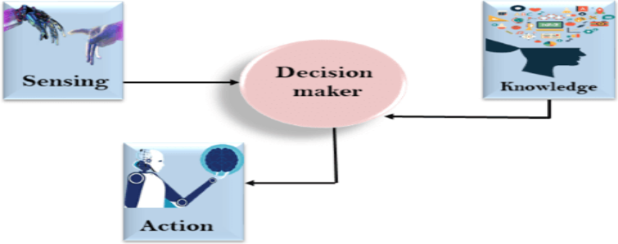
Relation between knowledge and intelligence
Knowledge of real-worlds plays a vital role in intelligence and same for creating artificial intelligence. Knowledge plays an important role in demonstrating intelligent behavior in AI agents. An agent is only able to accurately act on some input when he has some knowledge or experience about that input.
Let's suppose if you met some person who is speaking in a language which you don't know, then how you will able to act on that. The same thing applies to the intelligent behavior of the agents. As we can see in below diagram, there is one decision maker which act by sensing the environment and using knowledge. But if the knowledge part will not present then, it cannot display intelligent behavior.

Slide 8
Representations and Mappings
A variety of ways of representing knowledge (facts) have been exploited in AI programs. In all variety of knowledge representations, we deal with two kinds of entities.
A. Facts: Truths in some relevant world. These are the things we want to represent.
B. Representations of facts in some chosen formalism. These are things we will actually be able to manipulate One way to think of structuring these entities is at two levels:
(a) the knowledge level, at which facts are described,
(b) the symbol level, at which representations of objects at the knowledge level are defined in terms of symbols that can be manipulated by programs
The facts and representations are linked with two-way mappings. This link is called representation mappings. The forward representation mapping maps from facts to representations. The backward representation mapping goes the other way, from representations to facts.
One common representation is natural language (particularly English) sentences. Regardless of the representation for facts we use in a program, we may also need to be concerned with an English representation of those facts in order to facilitate getting information into and out of the system.
We need mapping functions from English sentences to the representation we actually use and from it back to sentences. Eg: Anon is a student: Student (Anon)

Slide 9
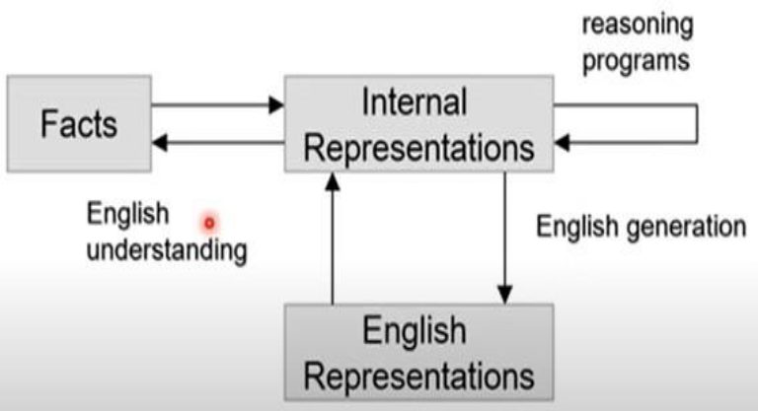
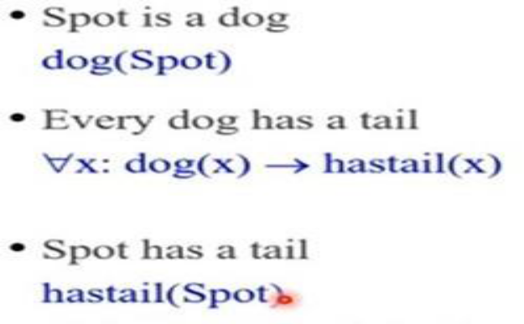
Mapping between Facts and Representation
Knowledge is a collection of facts from some domain.
Also, we need a representation of “facts” that can manipulate by a program.
Moreover, Normal English is insufficient, too hard currently for a computer program to draw inferences in natural languages.
Thus some symbolic representation is necessary.

Slide 10
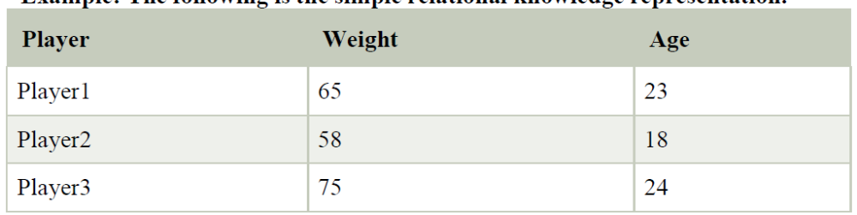
Approaches to knowledge representation
There are mainly four approaches to knowledge representation, which are given below:
1. Simple relational knowledge:
It is the simplest way of storing facts which uses the relational method, and each fact about a set of the object is set out systematically in columns.
This approach of knowledge representation is famous in database systems where the relationship between different entities is represented.
This approach has little opportunity for inference
Example: The following is the simple relational knowledge representation.

Slide 11
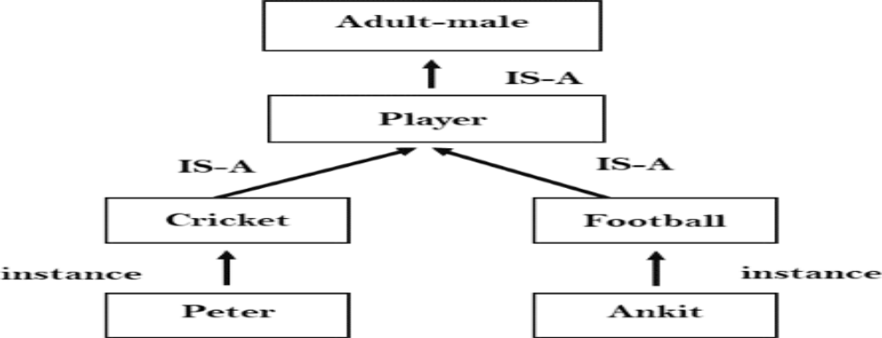
2. Inheritable knowledge:
In the inheritable knowledge approach, all data must be stored into a hierarchy of classes.
All classes should be arranged in a generalized form or a hierarchal manner.
In this approach, we apply inheritance property.
Elements inherit values from other members of a class.
This approach contains inheritable knowledge which shows a relation between instance and class, and it is called instance relation.
Every individual frame can represent the collection of attributes and its value.
In this approach, objects and values are represented in Boxed nodes.
We use Arrows which point from objects to their values.

Slide 12
3. Inferential knowledge:
Inferential knowledge approach represents knowledge in the form of formal logics.
This approach can be used to derive more facts.
It guaranteed correctness.
Example: Let's suppose there are two statements:
a. Marcus is a man
b. All men are mortal Then it can represent as;
man(Marcus)
∀x = man (x) ---------- > mortal (x)s

Slide 13
4. Procedural knowledge:
Procedural knowledge approach uses small programs and codes which describes how to do specific things, and how to proceed.
In this approach, one important rule is used which is If-Then rule.
In this knowledge, we can use various coding languages such as LISP language and Prolog language.
We can easily represent heuristic or domain-specific knowledge using this approach.

Slide 14
Requirements for knowledge Representation system
A good knowledge representation system must possess the following properties.
1. Representational Accuracy:
KR system should have the ability to represent all kind of required knowledge.
2. Inferential Adequacy:
KR system should have ability to manipulate the representational structures to produce new knowledge corresponding to existing structure.
3. Inferential Efficiency:
The ability to direct the inferential knowledge mechanism into the most productive directions by storing appropriate guides.
4. Acquisitional efficiency- The ability to acquire the new knowledge easily using automatic methods.

Slide 15
Techniques of knowledge representation
1. Logical Representation
Logical representation is a language with some concrete rules which deals with propositions and has no ambiguity in representation. Logical representation means drawing a conclusion based on various conditions. This representation lays down some important communication rules. It consists of precisely defined syntax and semantics which supports the sound inference. Each sentence can be translated into logics using syntax and semantics.
Syntax:
Syntaxes are the rules which decide how we can construct legal sentences in the logic.
It determines which symbol we can use in knowledge representation.
How to write those symbols.
Semantics:
Semantics are the rules by which we can interpret the sentence in the logic.
Semantic also involves assigning a meaning to each sentence. Logical representation can be categorized into mainly two logics:
a. Propositional Logics
b. Predicate logics
Advantages of logical representation:
1. Logical representation enables us to do logical reasoning.
2. Logical representation is the basis for the programming languages.
Disadvantages of logical Representation:
1. Logical representations have some restrictions and are challenging to work with.
2. Logical representation technique may not be very natural, and inference may not be so efficient.

Slide 16
2. Semantic Network Representation
Semantic networks are alternative of predicate logic for knowledge representation. In Semantic networks, we can represent our knowledge in the form of graphical networks.
This network consists of nodes representing objects and arcs which describe the relationship between those objects.
Semantic networks can categorize the object in different forms and can also link those objects. Semantic networks are easy to understand and can be easily extended.
This representation consists of mainly two types of relations:
a. IS-A relation (Inheritance)
b. Kind-of-relation

Slide 17
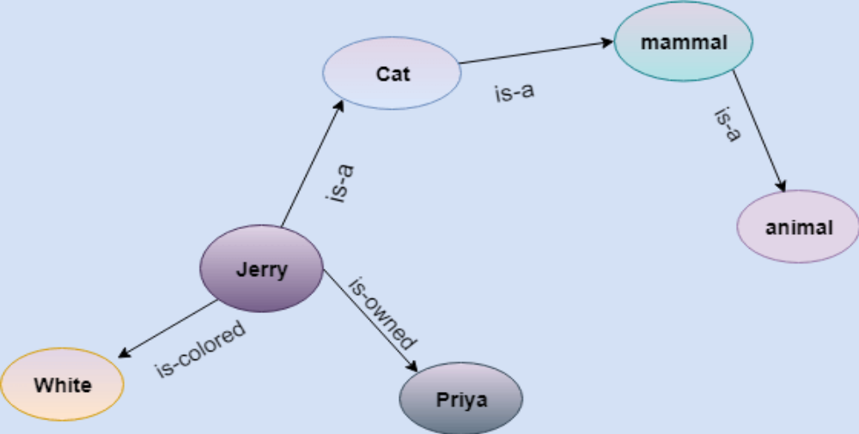
Example: Following are some statements which we need to represent in the form of nodes and arcs.
Statements:
a. Jerry is a cat.
b. Jerry is a mammal
c. Jerry is owned by Priya.
d. Jerry is brown colored.
e. All Mammals are animal.
In the above diagram, we have represented the different type of knowledge in the form of nodes and arcs. Each object is connected with another object by some relation.

Slide 18
Drawbacks in Semantic representation:
Semantic networks take more computational time at runtime as we need to traverse the complete network tree to answer some questions. It might be possible in the worst case scenario that after traversing the entire tree, we find that the solution does not exist in this network.
Semantic networks try to model human-like memory (Which has 1015 neurons and links) to store the information, but in practice, it is not possible to build such a vast semantic network.
These types of representations are inadequate as they do not have any equivalent quantifier, e.g., for all, for some, none, etc.
Semantic networks do not have any standard definition for the link names.
These networks are not intelligent and depend on the creator of the system.
Advantages of Semantic network:
Semantic networks are a natural representation of knowledge.
Semantic networks convey meaning in a transparent manner.
These networks are simple and easily understandable.

Slide 19
3. Frame Representation
A frame is a record like structure which consists of a collection of attributes and its values to describe an entity in the world. Frames are the AI data structure which divides knowledge into substructures by representing stereotypes situations. It consists of a collection of slots and slot values. These slots may be of any type and sizes. Slots have names and values which are called facets.
Facets: The various aspects of a slot is known as Facets. Facets are features of frames which enable us to put constraints on the frames. Example: IF-NEEDED facts are called when data of any particular slot is needed. A frame may consist of any number of slots, and a slot may include any number of facets and facets may have any number of values.
A frame is also known as slot-filter knowledge representation in artificial intelligence. Frames are derived from semantic networks and later evolved into our modern-day classes and objects. A single frame is not much useful. Frames system consists of a collection of frames which are connected. In the frame, knowledge about an object or event can be stored together in the knowledge base. The frame is a type of technology which is widely used in various applications including Natural language processing and machine visions.

Slide 20
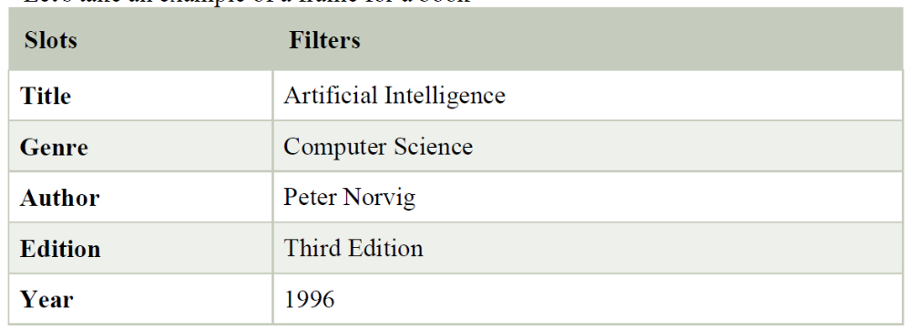
Example:
Let's take an example of a frame for a book
Advantages of frame representation:
The frame knowledge representation makes the programming easier by grouping the related data.
The frame representation is comparably flexible and used by many applications in AI.
It is very easy to add slots for new attribute and relations.
It is easy to include default data and to search for missing values.
Frame representation is easy to understand and visualize.
Disadvantages of frame representation:
In frame system inference mechanism is not be easily processed.
Inference mechanism cannot be smoothly preceded by frame representation.
Frame representation has a much generalized approach.

Slide 21
4. Production Rules
Production rules system consist of (condition, action) pairs which mean, "If condition then action". It has mainly three parts:
The set of production rules
Working Memory
The recognize-act-cycle
In production rules agent checks for the condition and if the condition exists then production rule fires and corresponding action is carried out. The condition part of the rule determines which rule may be applied to a problem. And the action part carries out the associated problem-solving steps. This complete process is called a recognize-act cycle. The working memory contains the description of the current state of problems-solving and rule can write knowledge to the working memory. This knowledge match and may fire other rules. If there is a new situation (state) generates, then multiple production rules will be fired together, this is called conflict set. In this situation, the agent needs to select a rule from these sets, and it is called a conflict resolution.
Example:
IF (at bus stop AND bus arrives) THEN action (get into the bus)
IF (on the bus AND paid AND empty seat) THEN action (sit down).
IF (on bus AND unpaid) THEN action (pay charges).
IF (bus arrives at destination) THEN action (get down from the bus).

Slide 22
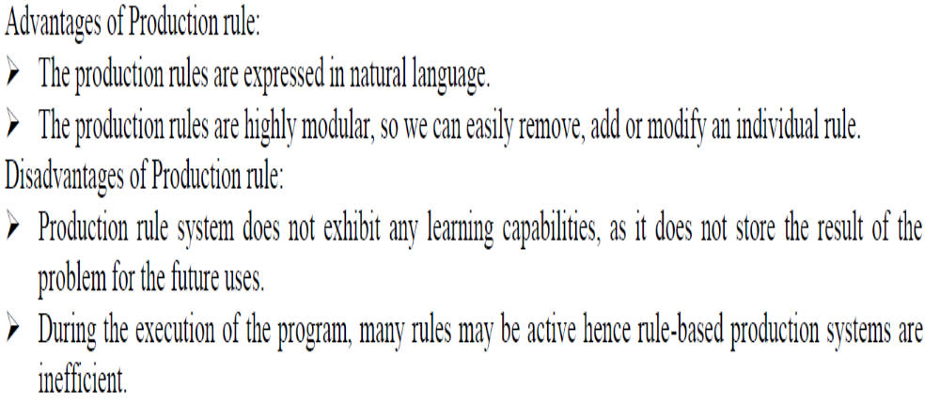

Slide 23
THANK YOU

